Slide 1
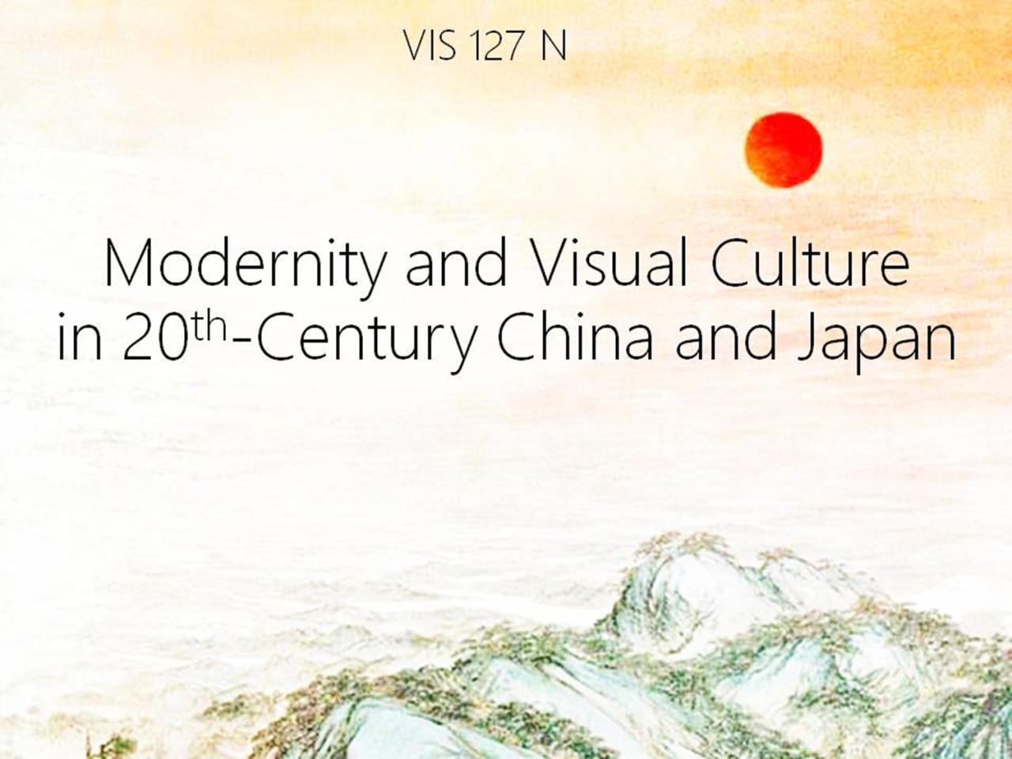

Slide 2
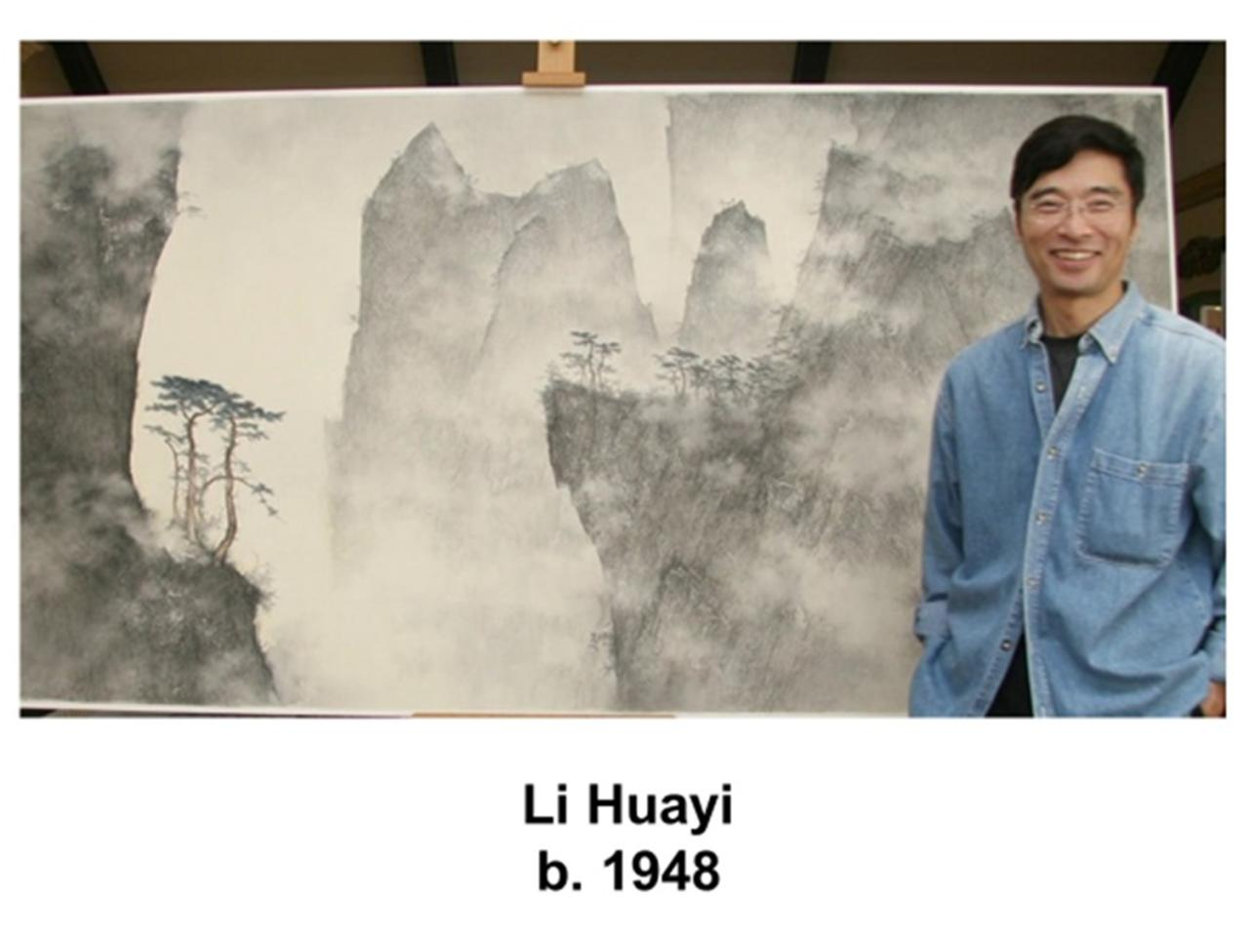

Slide 3
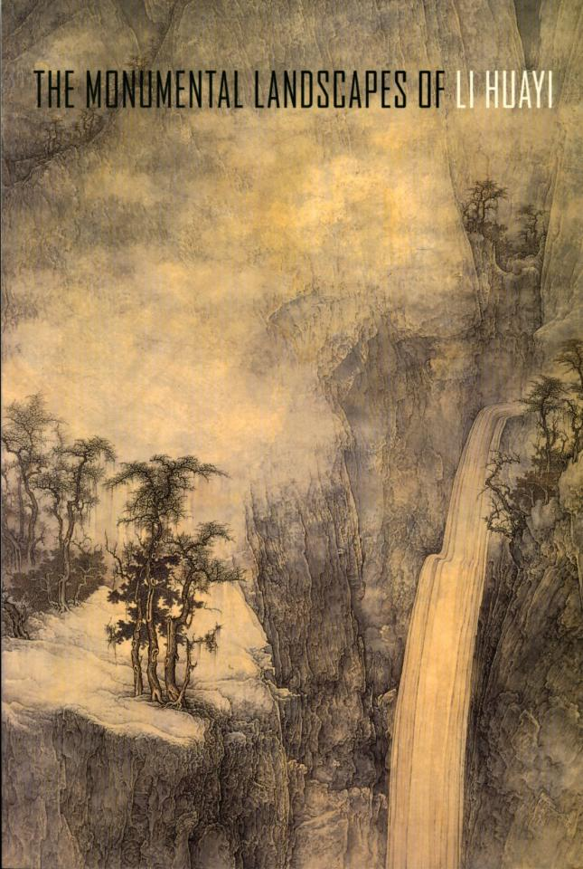

Slide 4
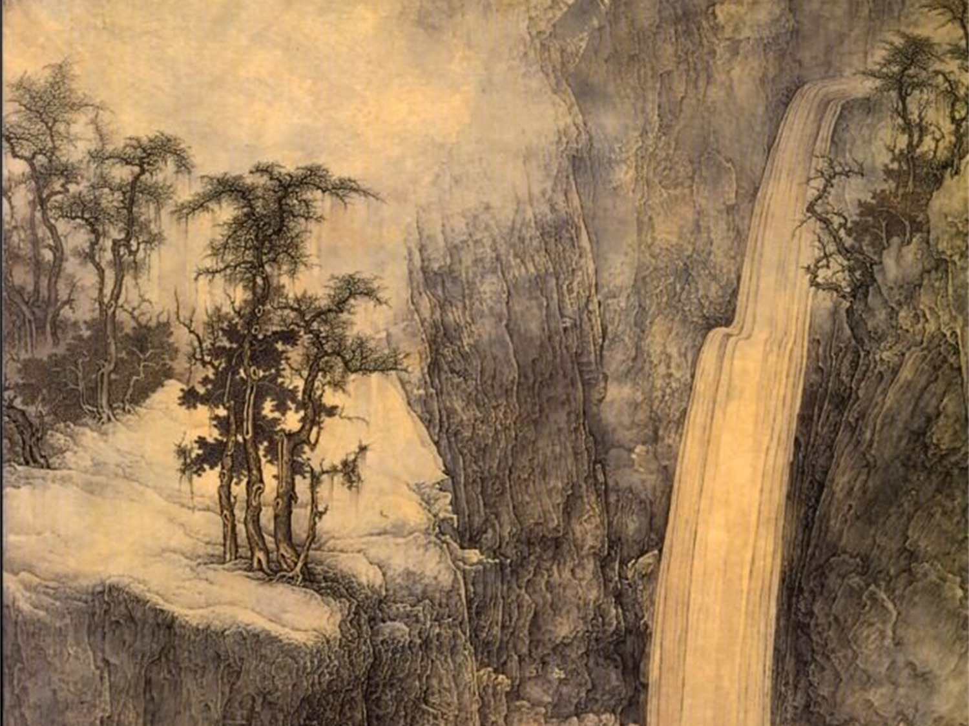

Slide 5
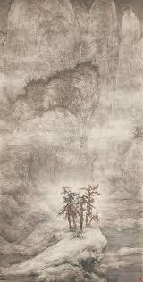
Li Huayi,
Snow-covered Mountains,
n.d.

Slide 7
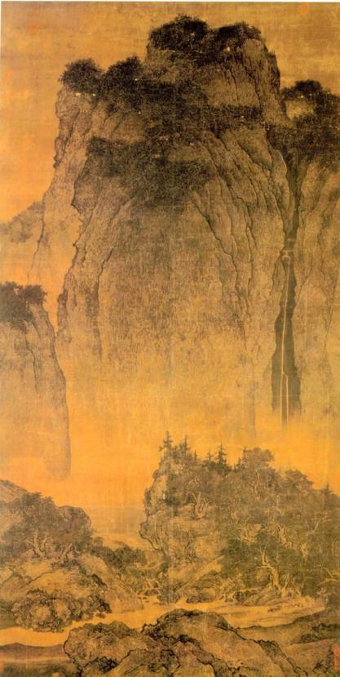
Fan Kuan,
Travelers among
Mountains and Streams,
Ink on silk,
before 1030

Slide 8
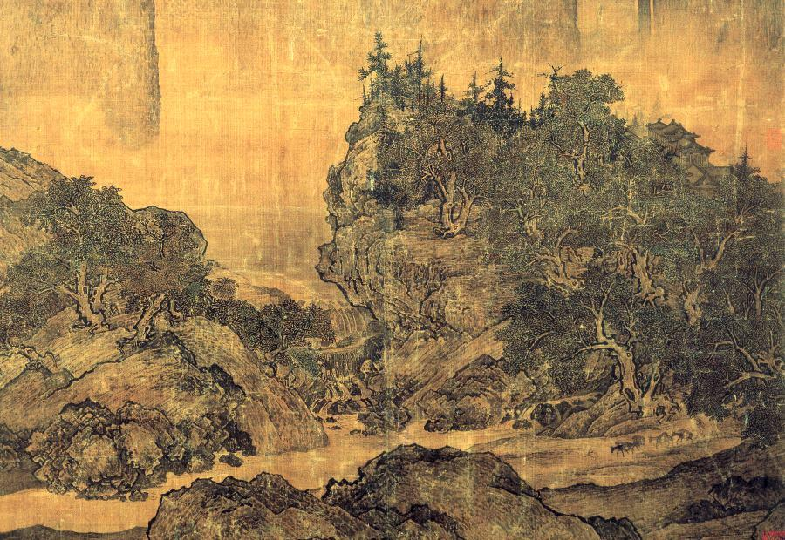

Slide 9
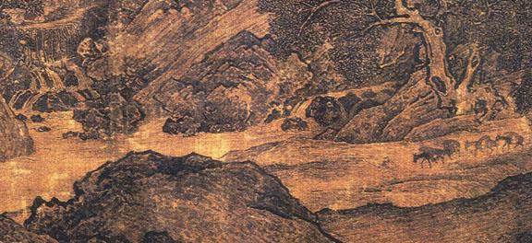

Slide 10
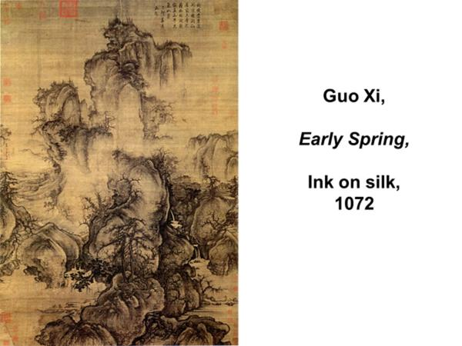

Slide 11
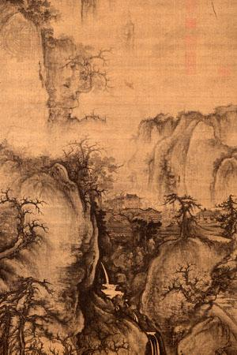

Slide 13



Slide 14
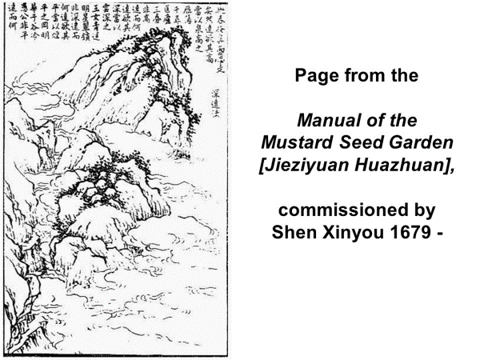

Slide 15
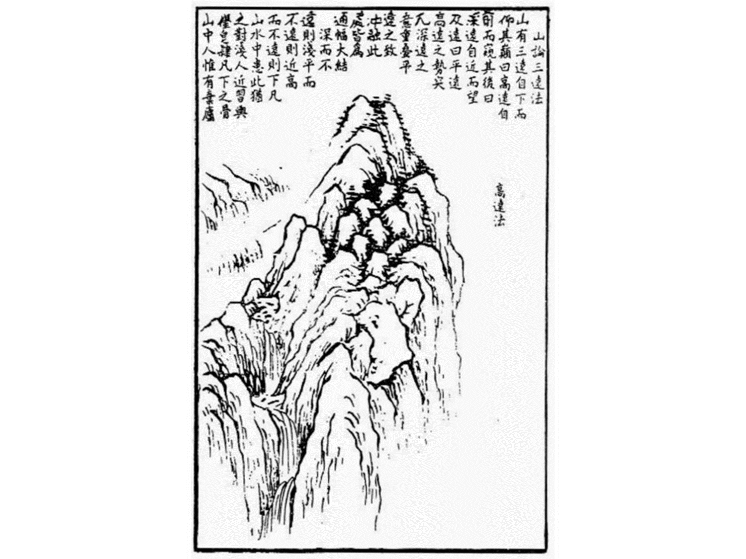

Slide 16
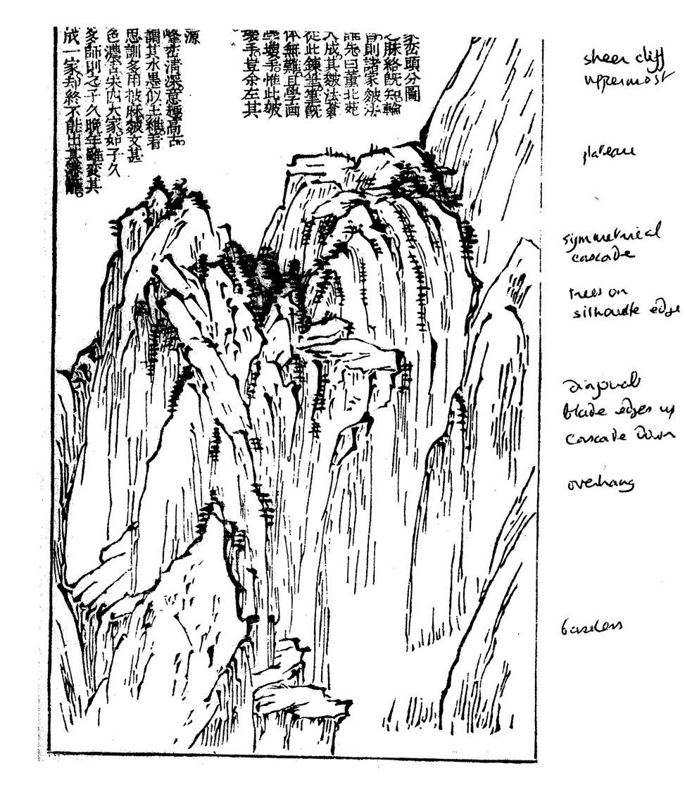

Slide 17
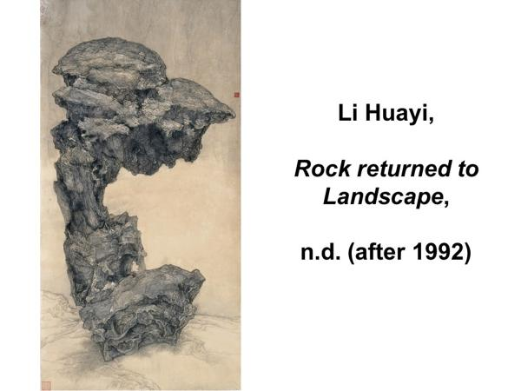

Slide 18
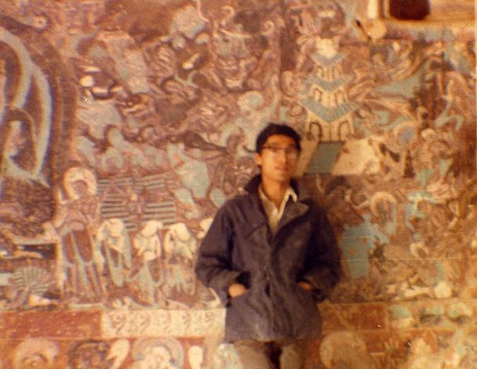

Slide 19
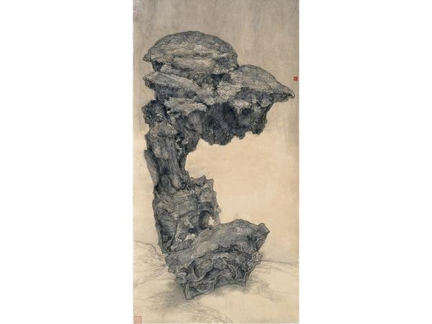

Slide 20
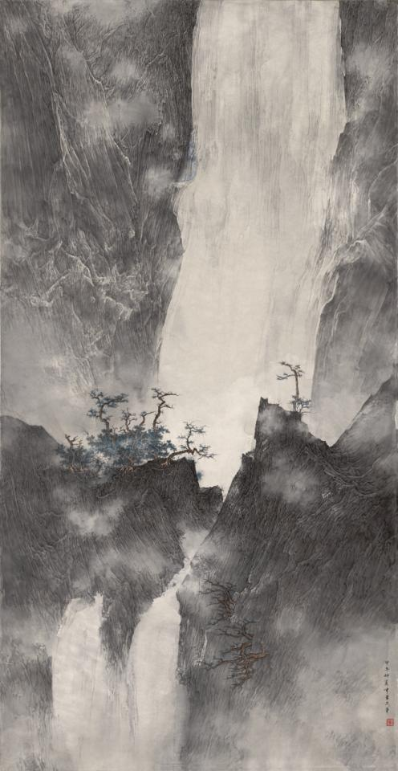
Li Huayi,
Pure Echo
in the Empty Valley,
2014

Slide 21
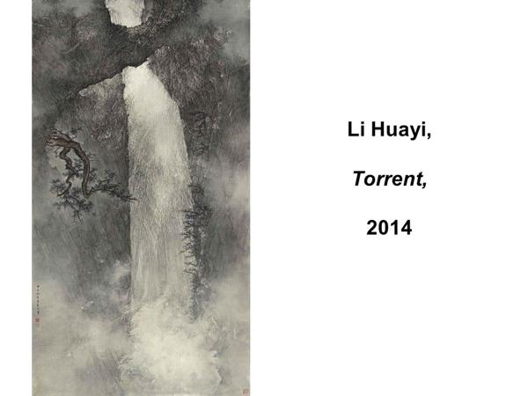

Slide 22
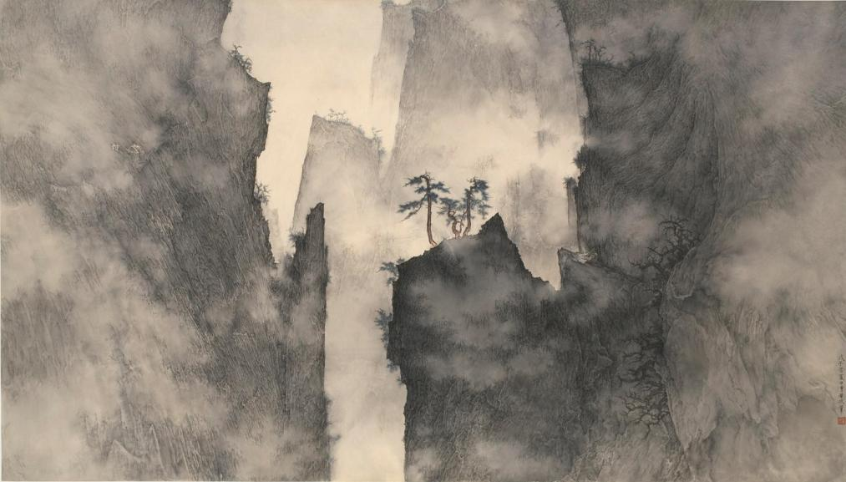
Li Huayi, Autumn Mountains, 2008

Slide 23


Slide 24
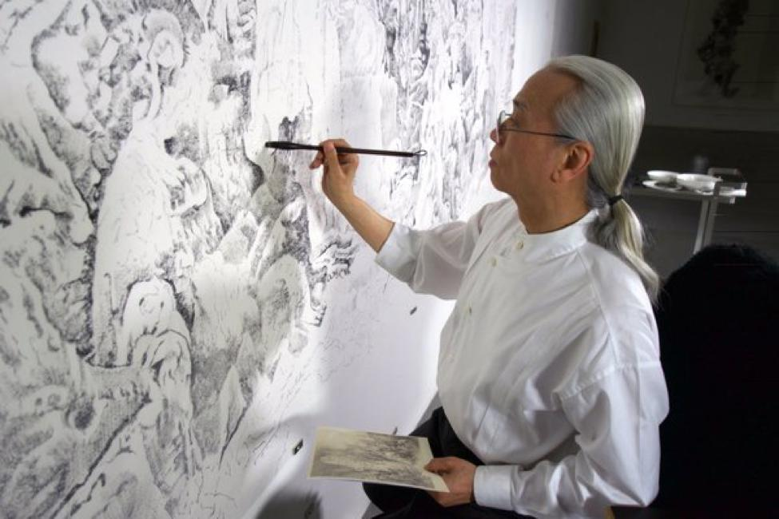
Liu Dan
b. 1953

Slide 25
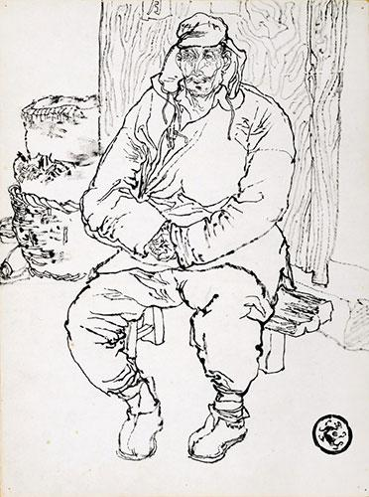
Liu Dan,
Shandong Farmers:
Farmer on a Bench,
1978

Slide 26
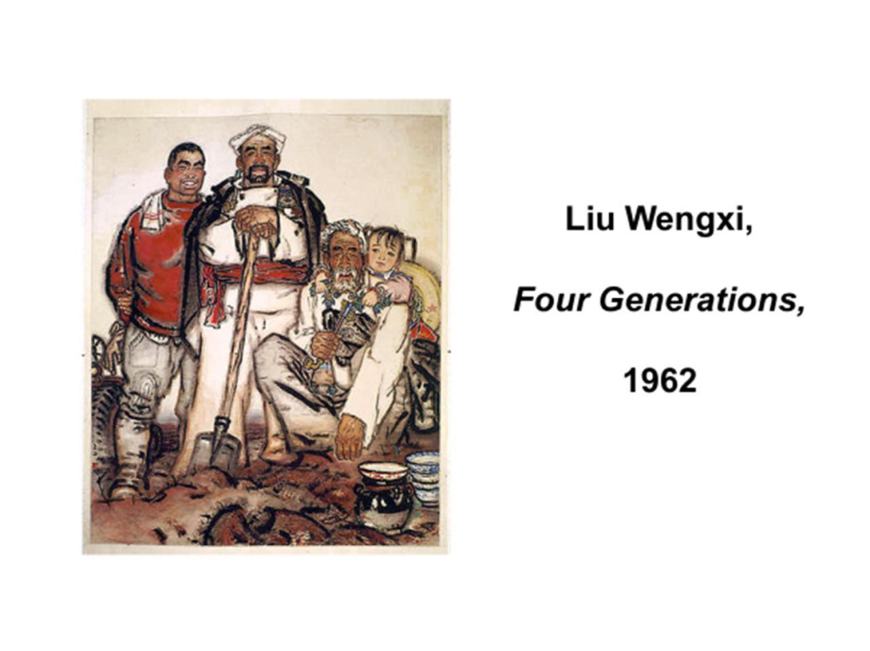

Slide 28
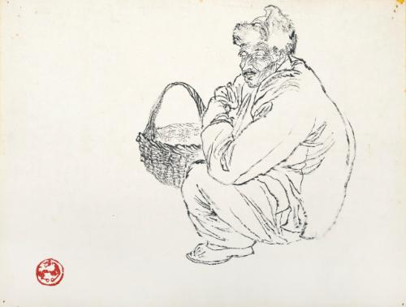
Liu Dan,
Shandong Farmers: Man with Basket, 1979

Slide 30
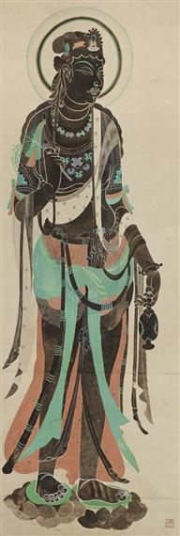
Liu Dan,
Avalokiteshvara,
(after a mural painting
at Dunhuang),
1979

Slide 31
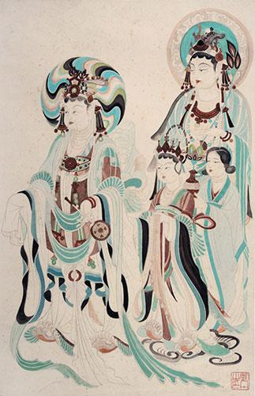
Liu Dan,
from
Visions of Dunhuang
1979

Slide 32
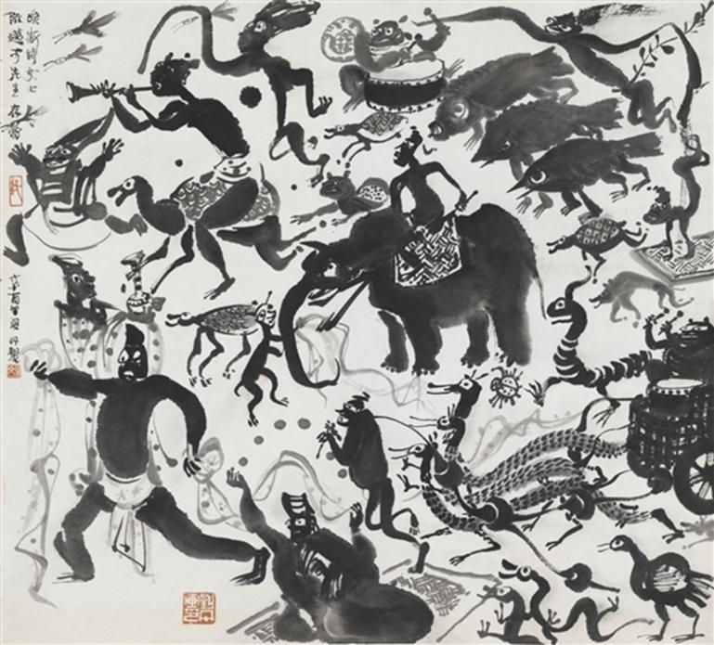
Liu Dan,
Warring States Procession, 1981

Slide 33
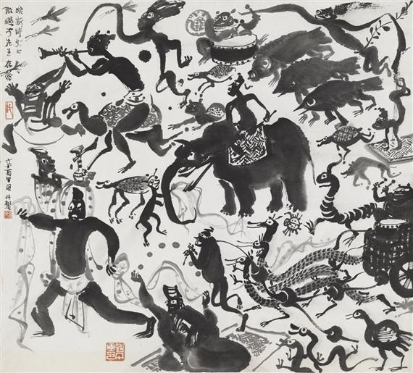

Slide 34
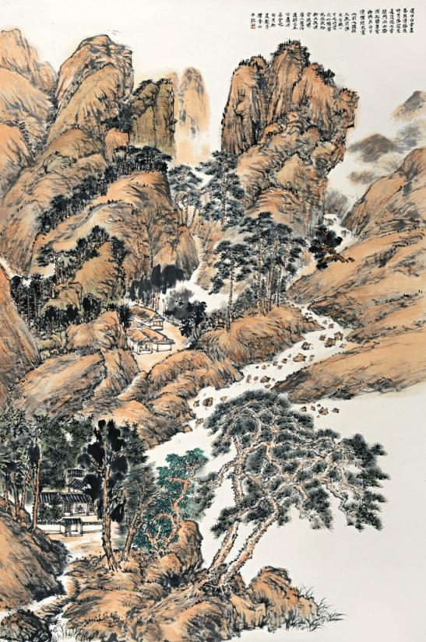
Liu Dan,
Landscape after
Shen Zhou,
1983

Slide 35


Slide 36


Slide 37
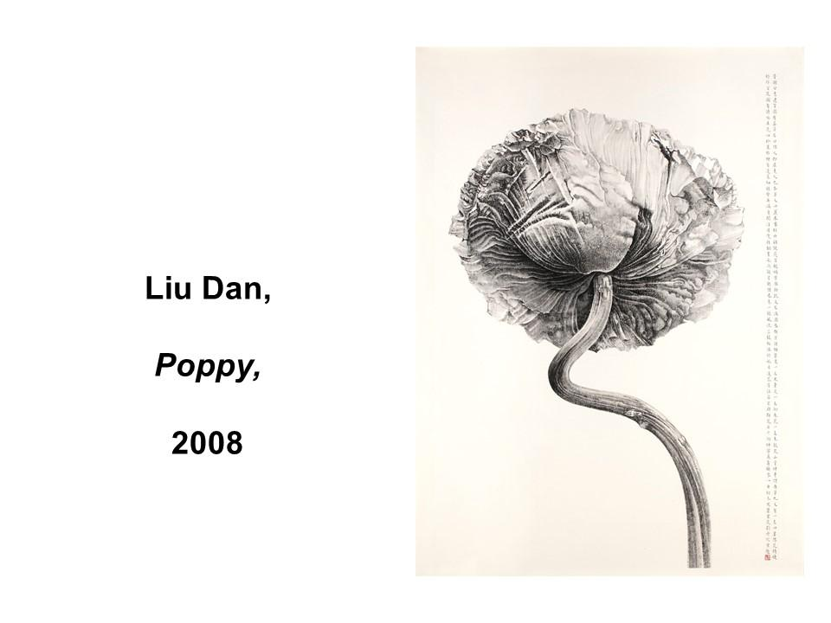

Slide 38
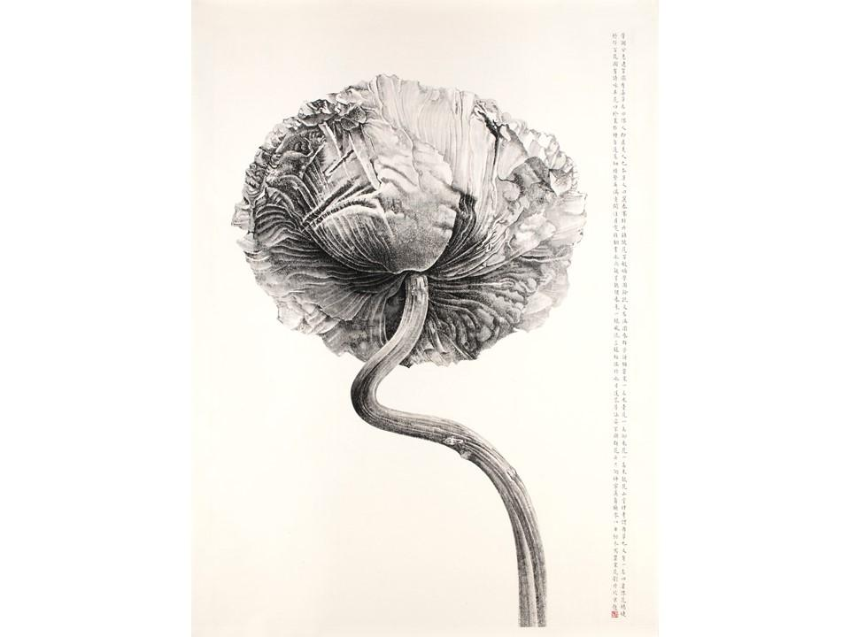

Slide 39
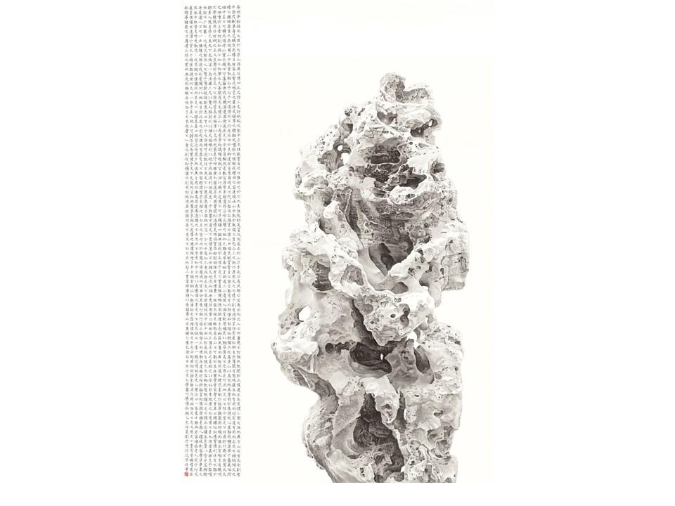
Liu Dan,
Taiho Rock of the
Shaoyuan Garden,
2015

Slide 41
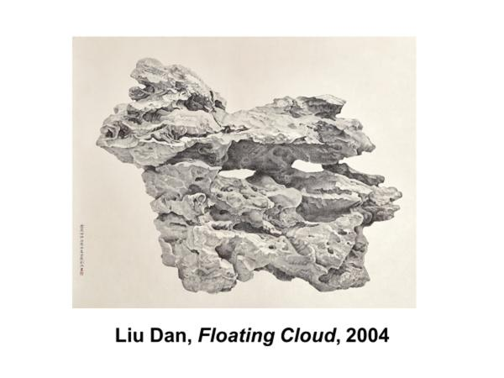

Slide 42
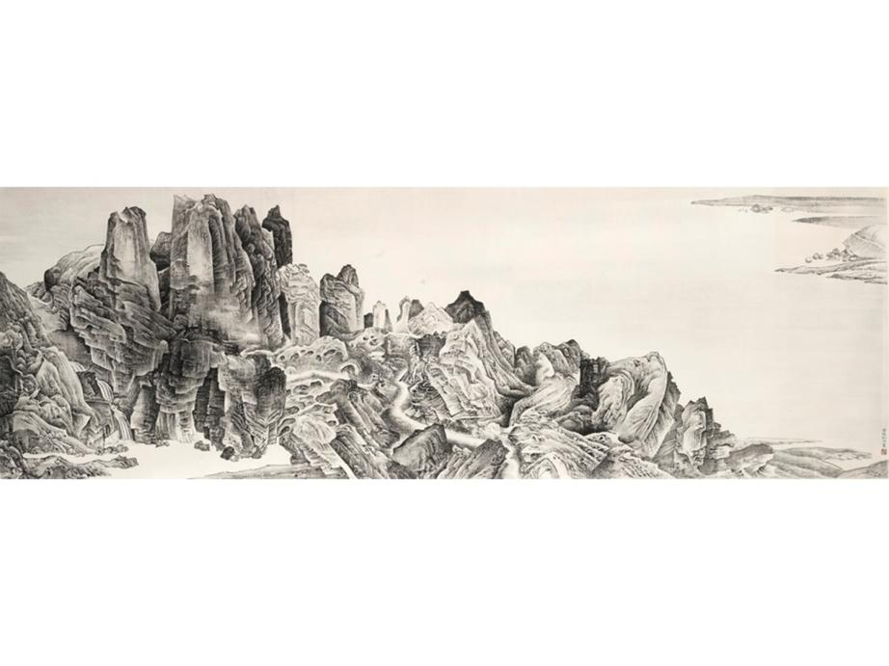
Liu Dan,
Airy Mountains, Rushing Glens after Li Tang,
2015
Liu Dan,
Airy Mounains, Rushing Glens after Li Tang,
2015

Slide 43
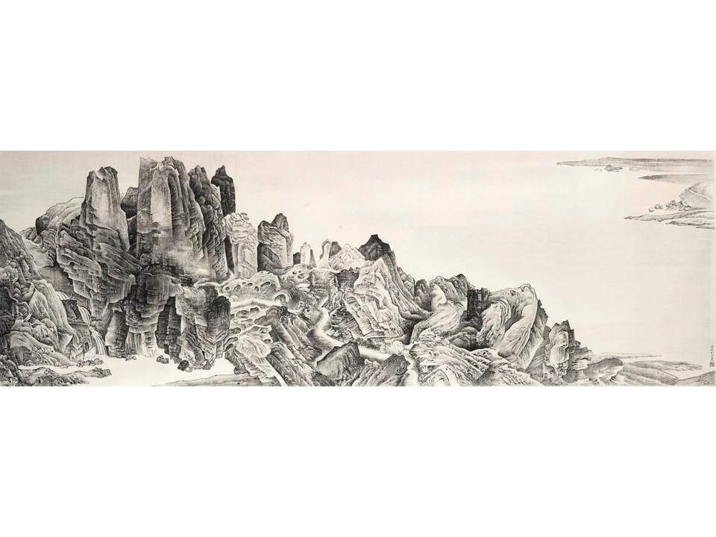

Slide 44
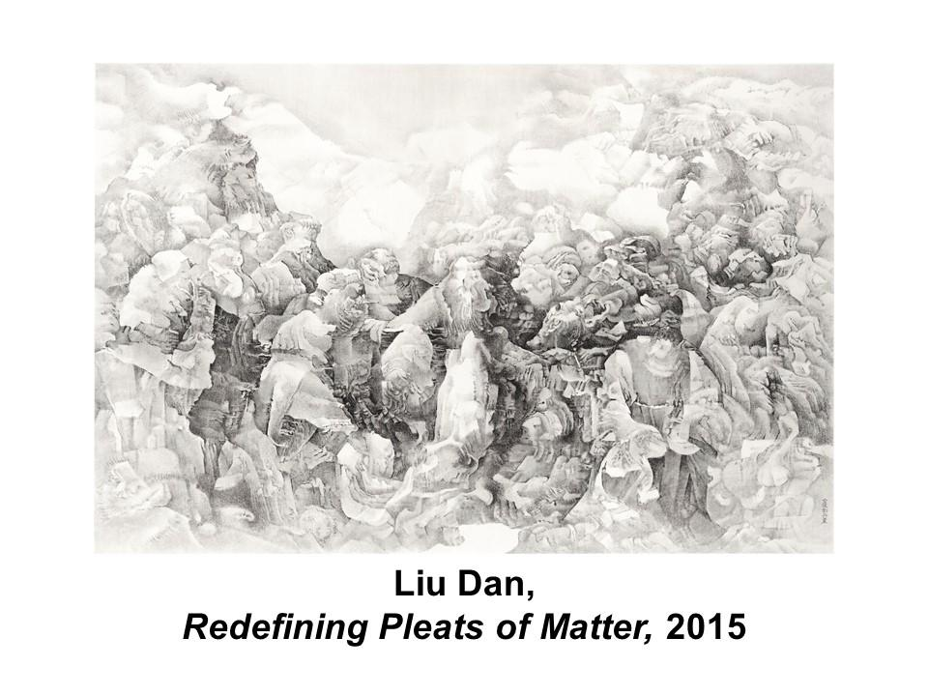

Slide 45
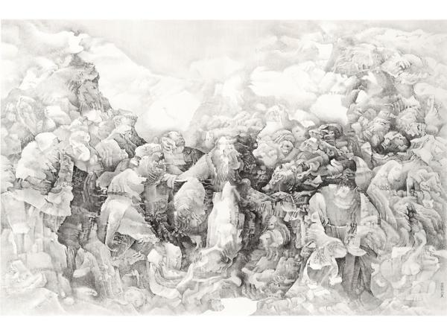

Slide 46
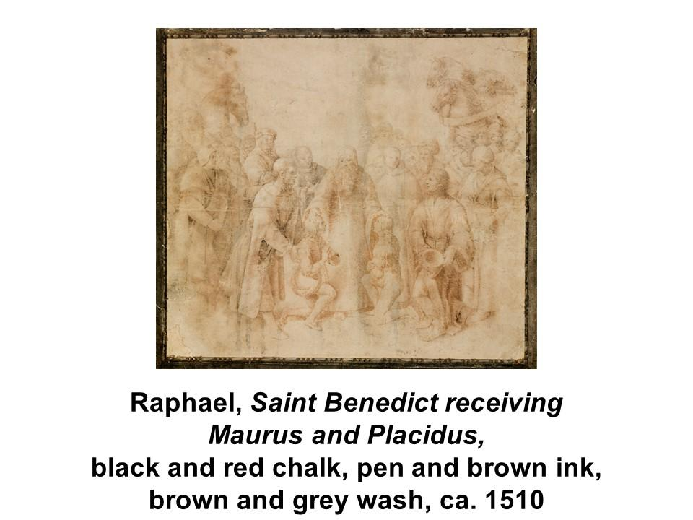

Slide 47
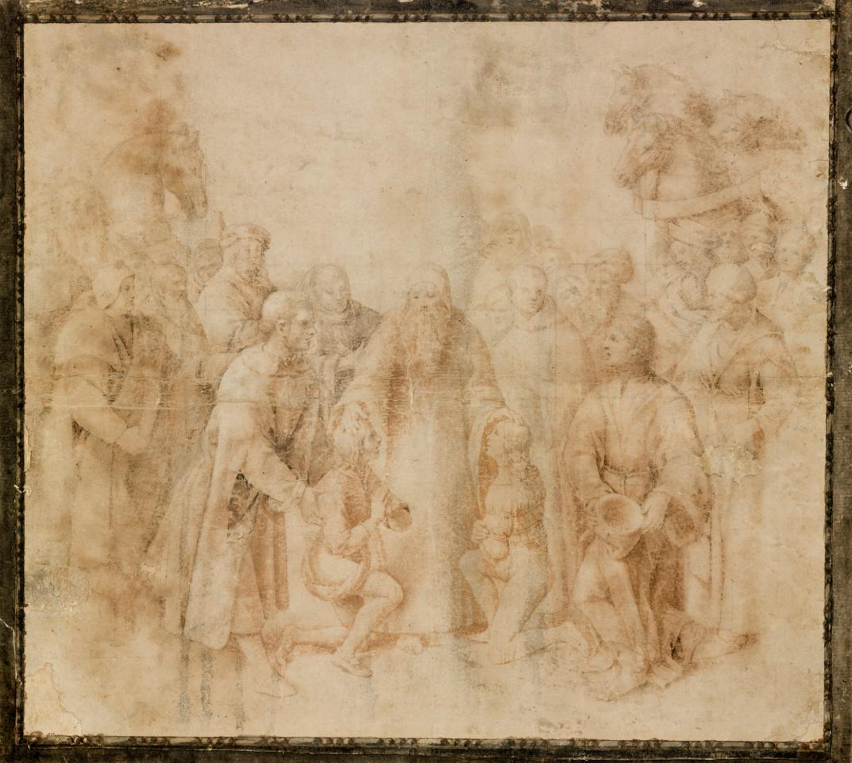

Slide 49
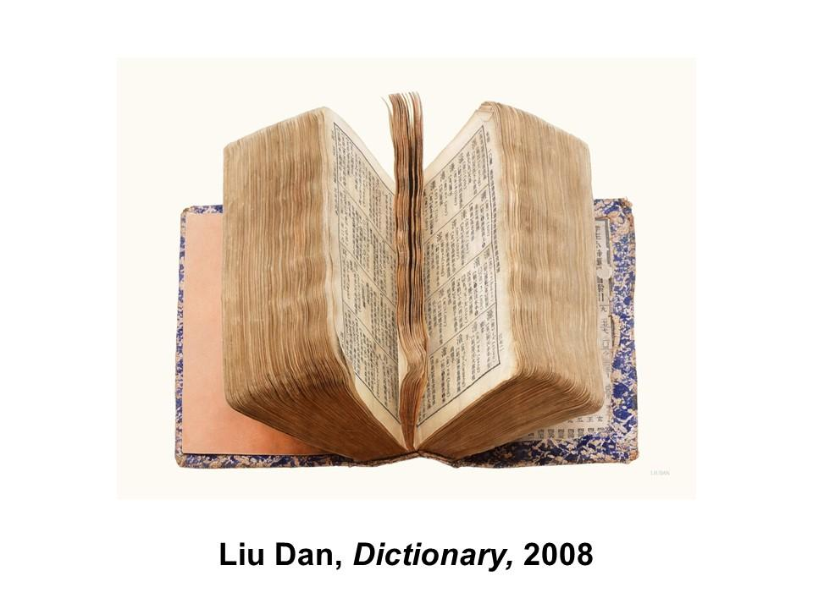

Slide 50
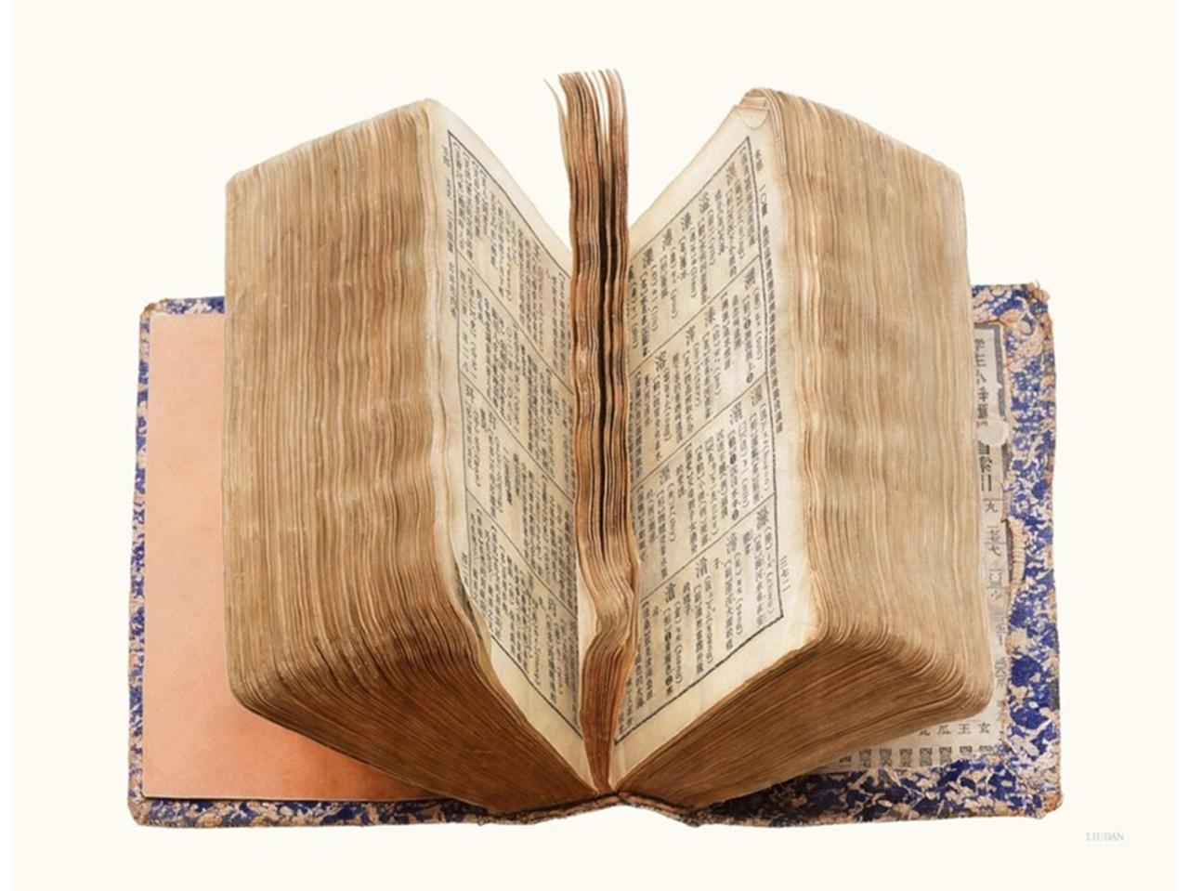

Slide 51
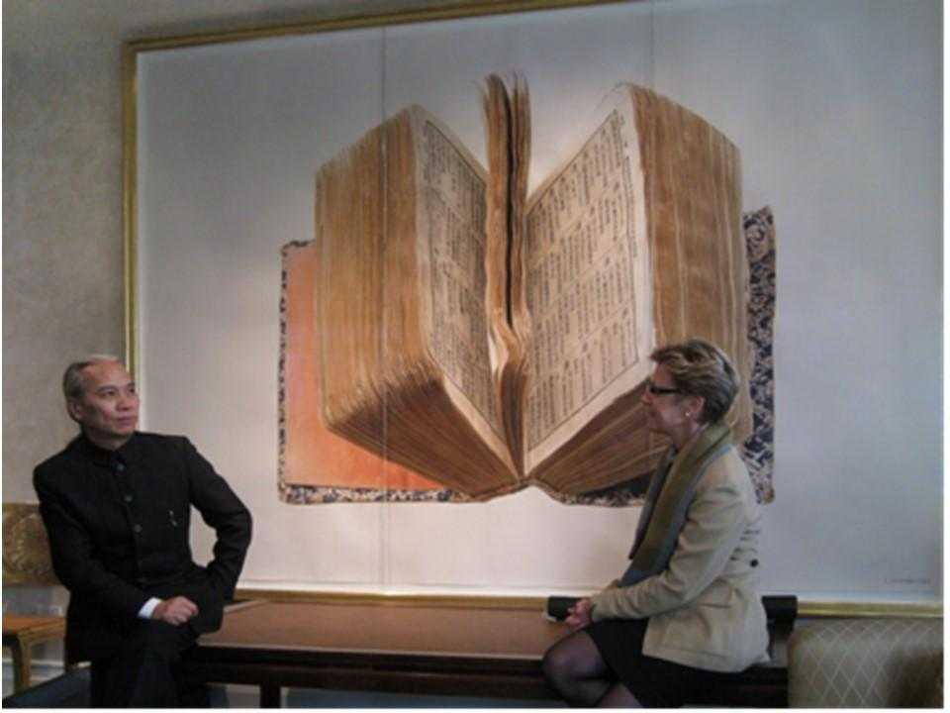

Slide 52


